Slide 1
OWL
The Web Ontology Language (OWL) was designed as an extension of RDF Schema.
OWL added properties such as owl:maxCardinality to express so-called restrictions.
A very important thing to note is that, like RDFS, OWL was designed for inferencing which means that OWL restrictions are not actually data constraints, but rather describe inferences to be applied based on them.
For many first-time users of OWL this leads to some very surprising outcomes. For example, assuming there is an owl:maxCardinality 1 restriction stating that a person can only have 1 value for ex:hasFather and there is an instance of ex:Person that has two ex:hasFather values, then an OWL processor will assume that these two values must in fact represent the same real-world entity, just with different URIs.
OWL cannot be used as a validator

Slide 2
OWL
OWL is based on Open World Assumption, which means that an application should not assume that the absence of a certain statement means that the statement is false. For example, if an OWL ontology states that the rdfs:range of the property ex:hasFather is ex:Person and an application only sees a triple stating ex:John ex:hasFather ex:Bob and nothing else then it should not assume that ex:Bob is an not instance of ex:Person. In fact, the application should assume the opposite, and automatically infer the triple ex:Bob rdf:type ex:Person.
Another surprise for newer OWL users is that missing a value for a property with a restriction of owl:minCardinality 1 is not reported as an error by an OWL processor, because more data may appear at any time to satisfy that restriction under the Open-World Assumption.

Slide 3
SHACL
SHACL is based on Closed World Assumption
The high-level vocabulary makes SHACL also a schema/ontology language, allowing tools to examine the structure of a class to, for example, suggest how instances of a class should be presented on an input form.
Since OWL performs limited data validation through inferencing, it has no separation between data validation and reasoning. SHACL separates checking data validity from inferring new facts. Both, however, are possible with SHACL
With some notable exceptions, the expressivity of OWL is comparable to the SHACL Core vocabulary. A syntactic translation between OWL and SHACL is straight-forward in most cases.
There are some use cases that cannot be covered by OWL. For example, to state that values of schema:address can be either resources of type schema:PostalAddress or literals with datatype xsd:string is not possible in OWL because object and datatype properties are disjoint. Check https://spinrdf.org/shacl-and-owl.html#:~:text=A%20difference%20between%20OWL%20and,for%20example%20using%20sh%3AtargetObjectsOf%20 for more use cases

Slide 4
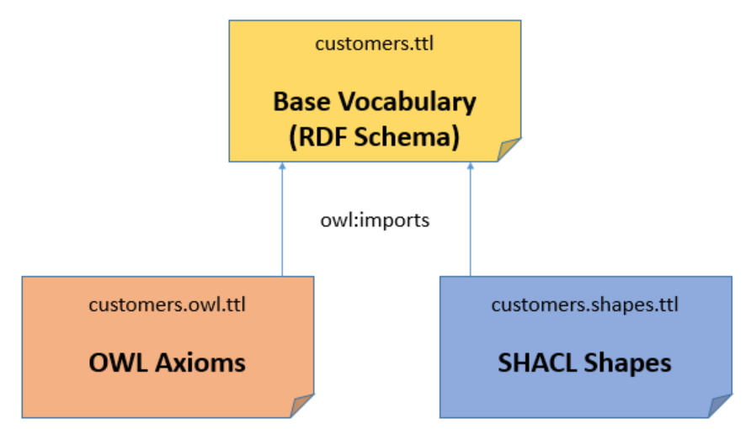
OWL with SHACL
Based on URIs and graphs, it is perfectly fine for any URI resource to carry different triples for different purposes. If you define a class with the URI ex:Customer then you may attach both OWL axioms and SHACL constraints to the same class. In order to keep things tidy and organized, it is advisable to create multiple graphs in multiple files, as illustrated and explained as follows:
As a result of this design, applications can dynamically decide which features of the data model they need for their specific task, by merging the sub-graphs that they require. A SHACL validator does not need the OWL axioms and vice versa.

Slide 5
OWL with SHACL
That means that we have to express the same cardinality restrictions in two ways, which may be redundant and extra work, in many practical scenarios the OWL axioms will cover different things than the SHACL constraints. As long as they use the same URIs for the same classes, instance data can be used in both contexts.
In some use cases, SHACL's closed-world assumption does not work well. Your data may have links to external RDF resources that are not part of the graph that is being validated. For example, your sales database may reference a customer by a URI via ex:customer ex:JohnDoe but there is no triple stating that ex:JohnDoe is actually an instance of ex:Customer. In such cases, using a closed-world sh:class ex:Customer constraint would be a poor choice. Such cases can typically be covered with rdfs:range statements, which provide tools with a hint of the nature of values without being overly strict. A SHACL shape may limit itself to stating that the values must be URIs, using sh:nodeKind sh:IRI.
It is perfectly doable to combine OWL and SHACL with their individual strengths. An OWL inferencing engine basically takes an OWL ontology (plus instances) as input and produces new triples. These new, inferred, triples can be added to the graph which is then sent to the SHACL validation engine. Many implementations of OWL and RDF Schema can even perform these inferences on-the-fly by activating a switch.

